Slide 1
Rwanda SAM Toolkit
Standardized Approach to Building & Updating SAMs

Slide 2

SAM-Building Toolkit
Reconciles data from multiple sources
  Core toolkit tailored to national statistical reports
  Final data reconciliation uses cross-entropy estimation
  Coded in Microsoft Excel® and GAMS®
Macro data
Supply-use table
Micro data
National accounts (SNA 2008)
Balance of payments (IMF BOP6)
Gov. finance (IMF GFSM2014)
Rebased national accounts
Agriculture censuses + surveys
Industrial firm surveys
Agriculture production (FAOSTAT)
Industrial + economic surveys
Energy balance (IEA)
Trade flows (COMTRADE)
Tariffs (TRAINS)
Labor force surveys
Household surveys (LSMS)

Slide 3
Process
Step 1: Macro SAM
Single aggregate activity, commodity, labor and household accounts
Step 2: Supply-Use Table
Disaggregate and balance activity and commodity accounts
Step 3: Income Distribution
Disaggregate and balance labor and household accounts

Slide 4
Toolkit Files
SUT Coefficients
SUT_2017.xlsx
Step 1
Step 2
Build and Balance 1national.gms
2balance.gms
Prior National SAM NAT_2017.xlsx
Excel: Build Macro SAM; split activities & commodities
GAMS: Press F9
Process survey data
Stata do files
Step 4
Step 3
Build and Balance 3household.gms 4balance.gms
Prior Household SAM HHD_2017.xlsx
Excel: Split households
GAMS: Press F9
Balanced SAMs
SAM_2017.xlsx

Slide 5
Step 1: Macro SAM
Constructing aggregate accounts

Slide 6
Data Sources
Three main data sources:
National Accounts (activity and commodity accounts)
Government Financial Statistics (spending and tax accounts)
Balance of Payments (external account)

Slide 7
Worksheet Names
Black & gray sheets
  Notes and GAMS parameters
Blue sheets
  Final data imported directly into GAMS
Green sheets
  Working sheets with original data, transformed into GAMS-ready formats
  Updated frequently (every year) – national accounts, trade flows, etc.
Red sheets
  Working sheets with original data
  Updated less frequently (every few years) – survey data, SUT coefficients
1NAT_X104_2017.xlsx

Slide 8
Macro SAM Sheets
wGFS Government Financial Statistics
wBOP Balance of Payments
wGDPe National Accounts (GDP expenditure-side)
wGDPp National Accounts (GDP production-side)
wMAC Consolidation sheet for balancing Macro SAM
MAC Final Macro SAM imported into GAMS
1NAT_X104_2017.xlsx

Slide 9
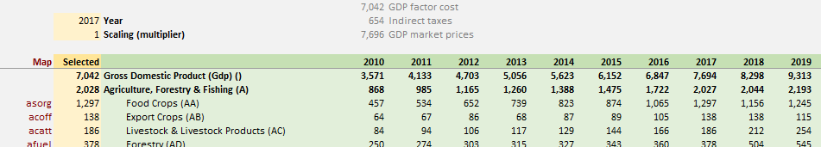
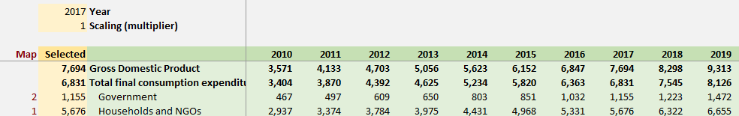
Action 1 | National Accounts
Enter data for new year (check year points to correct data)
Gross Domestic Product by Production Sector
Gross Domestic Product by Expenditure Category

Slide 10
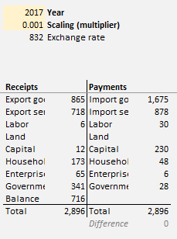
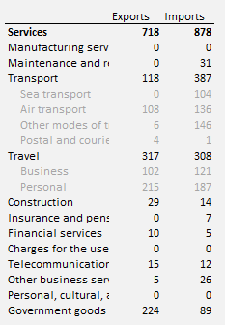
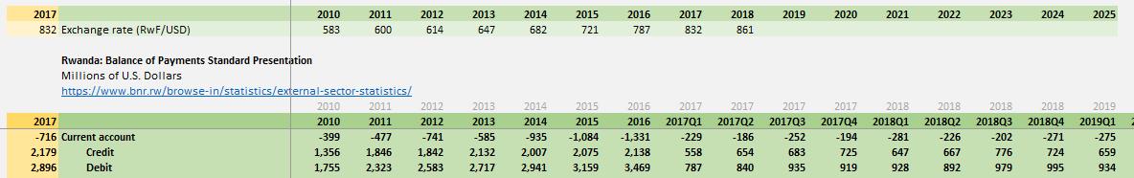
Action 2 | Balance of Payments
Enter data for new year (check year)
Generates T-Account used to construct Macro SAM
Also compiles trade in services (used in Step 2)
Macro SAM T-Account
Trade in Services
Balance of Payments

Slide 11
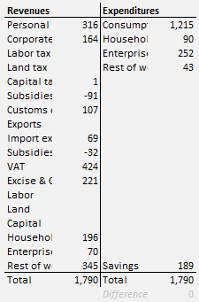
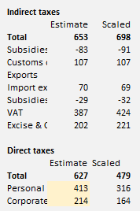
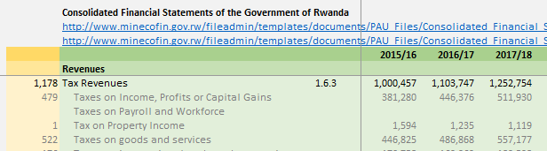
Action 3 | Gov. Financial Statistics
Enter data for new year (check year)
Generates T-Account used to construct Macro SAM
Direct taxes are scaled to match national accounts
Macro SAM T-Account
Fiscal Accounts
Additional information needed to separate personal and corporate (direct) taxes

Slide 12
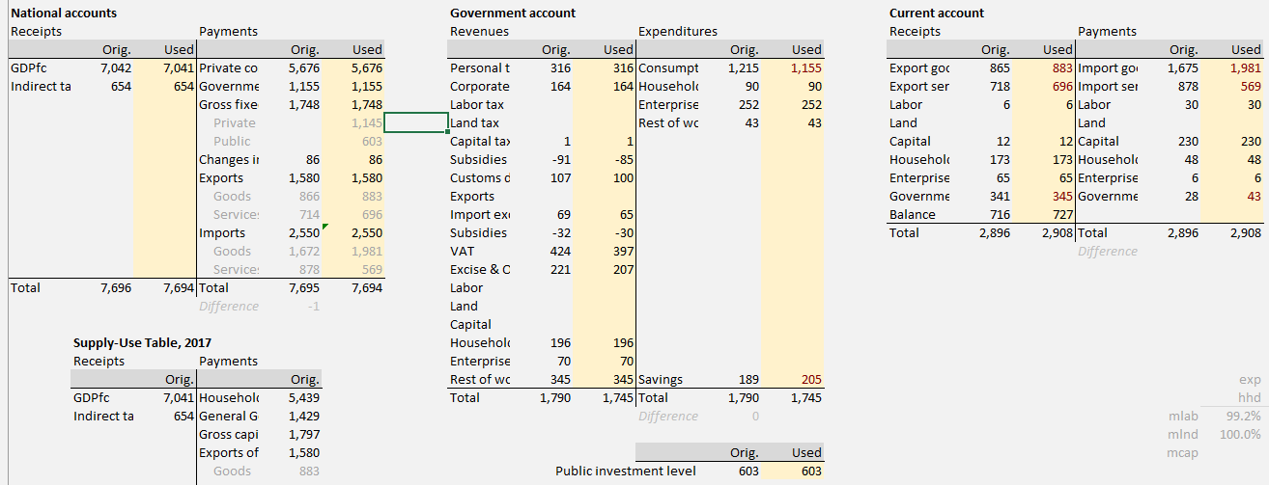
Action 4 | Final Macro SAM (1)
Check that all three T-Accounts are balanced (difference = zero)
  Error may be in original data (check previous worksheets)
Macro SAM

Slide 13
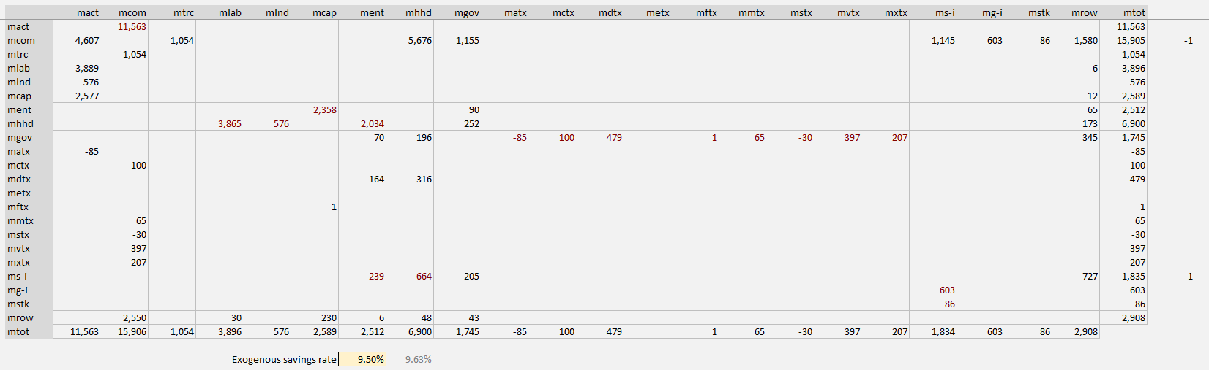
Action 4 | Final Macro SAM (2)
Cross-entropy is NOT used to balance the Macro SAM
Row and column totals should be effectively zero
Manually adjust enterprise savings rate

Slide 14
Step 2: Supply-Use Table
Disaggregating activities and commodities

Slide 15
Data Sources
Main data sources:
National accounts
Supply-use table
Agricultural and industrial production data
Trade and tax data
Household expenditure survey
Inconsistent values across sources requires reconciliation:
Balanced using cross-entropy techniques in GAMS®

Slide 16
SUT Sheets
wGDPp GDP at factor cost by sector
  wAGR Agriculture production data
  wIND Industrial production data
  wSRV Services production data
wTRD Imports and Exports (X + M)
wTAX Indirect taxes on producers & products
wABS Absorption vectors (C + I + G)
wTRC Transaction cost margins
wUSE Use table coefficients (from 1SUT_X104_2017.xlsx)
wSUP Supply table coefficients (from 1SUT_X104_2017.xlsx)
NAT_2017.xlsx

Slide 17
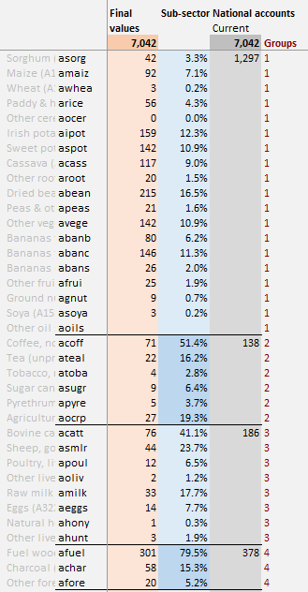
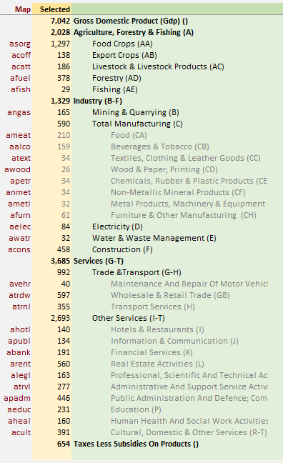
Action 5 | National Accounts
National accounts provides some breakdown of GDP by sector
BUT sub-sector shares must be drawn from other sources
Subsector (sub-group) shares
Mapping aggregates to SAM

Slide 18
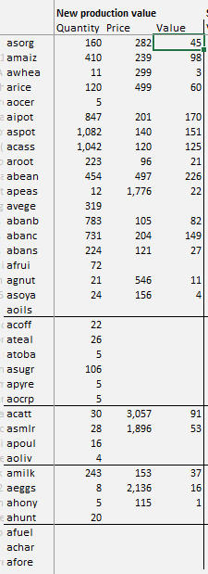
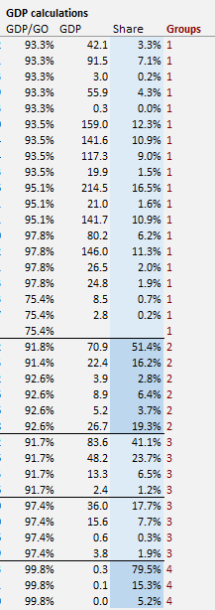
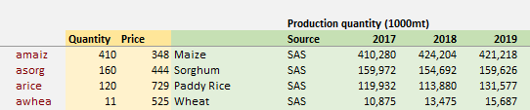
Action 6 | Agriculture
Enter new agricultural production data
Currently uses combination of SUT2017 and other sources
Estimating sub-group shares from production quantity and price data

Slide 19
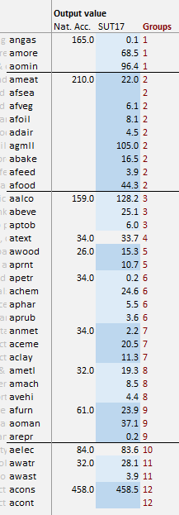
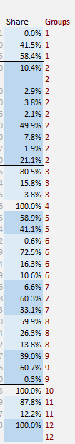
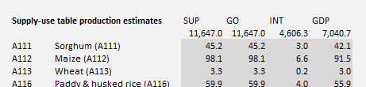
Action 7 | Industry
Industrial production data from national accounts and SUT2017
  NA updated annually
  SUT2017 periodically
Sub-group shares from production data
Manufacturing subsector GDP from national accounts
Further disaggregation from SUT2017
GDP by detailed sector from SUT2017 (see xNA sheet)

Slide 20
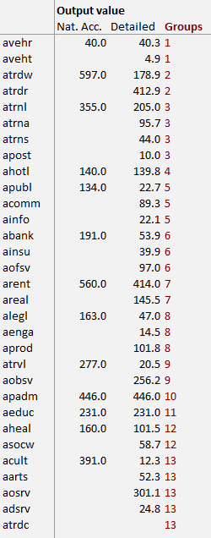
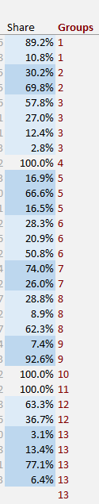
Action 8 | Services
Services production data from national accounts and SUT2017
  NA updated annually
  SUT2017 periodically
Sub-group shares from production data
Services subsector GDP from national accounts
Further disaggregation from SUT2017
GDP by detailed sector from SUT2017 (see xNA sheet)

Slide 21
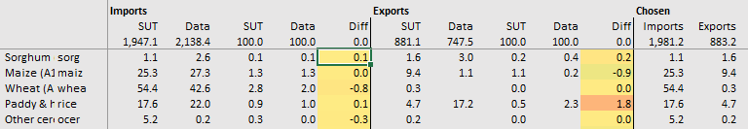
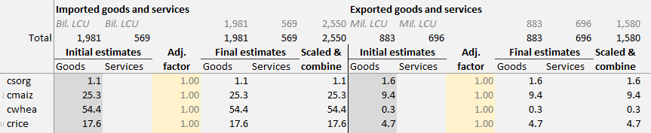
Action 9 | International Trade (1)
Goods trade from detailed HS 6-digit imports and exports data (stored in SUT_2017.xlsx)
Services trade from balance of payments (see Action 2)
Trade data by commodity (see SUT_2017.xlsx)
Import and export shares applied to national accounts aggregates

Slide 22
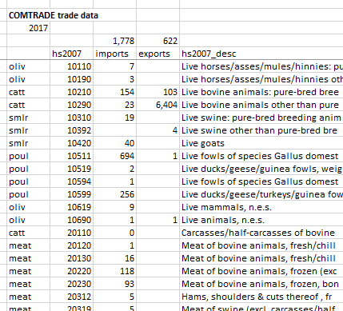
Action 9 | International Trade (2)
SUT_2017.xlsx
Enter new data on imports and exports of goods
Select whether to use new or SUT2017 data
Goods trade data from COMTRADE
Trade data by commodity

Slide 23
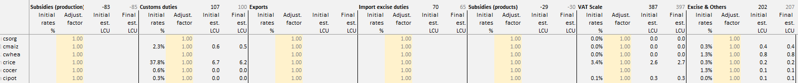
Action 10 | Indirect Taxes (1)
Taxes on production and products entered as RATES and then collections are estimated based on demand/supply data in SUT
  Subsidies on production
  Customs duties collected on imports
  Export taxes on exported products
  Import excise duties on imported products
  Subsidies on products
  VAT on products
  Excise and other product taxes
Initial indirect tax rates, estimated collection, and scaled collections

Slide 24
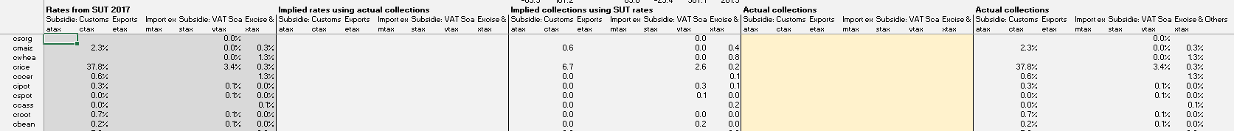
Action 10 | Indirect Taxes (2)
Indirect tax collections are reported in SUT2017
  Can either retain SUT2017 product level rates
  Or provide new data on actual tax collections
SUT2017 rates recorded in SUT_2017.xlsx (see next slide)
  Implied collections calculated by combining with supply/demand in SUT
Actual collections entered in NAT_2017.xlsx (see xTAX sheet)
  Rates are derived by combining collections and product demand/supply from SUT sheet

Slide 25
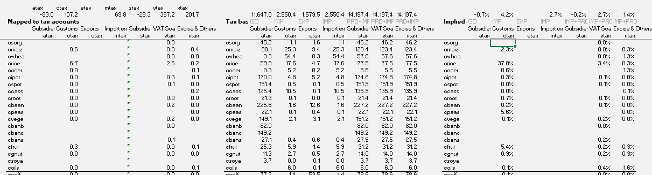
Action 10 | Indirect Taxes (3)
SUT_2017.xlsx
SUT2017 indirect tax rates estimated using collections and tax base for each product
  e.g., Custom duties / Import value = Import tariff rate
Tax collections
Tax base
Implied tax rate

Slide 26
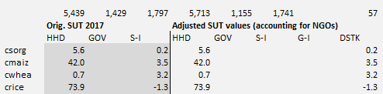
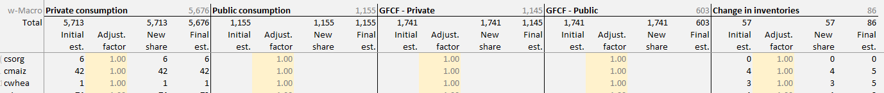
Action 11 | Absorption (1)
Absorption data (C + I + G) comes from SUT2017 (default) or other sources (incl. household survey)
Data recorded on xNA sheet
Private and public consumption, gross fixed capital formation (public and private), and inventory changes

Slide 27
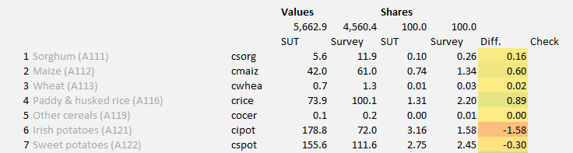
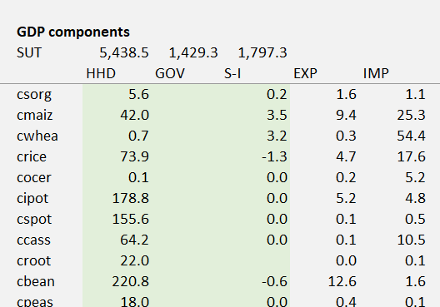
Action 11 | Absorption (2)
SUT_2017.xlsx
GDP by expenditure category data from SUT2017
Data recorded on xNA sheet

Slide 28
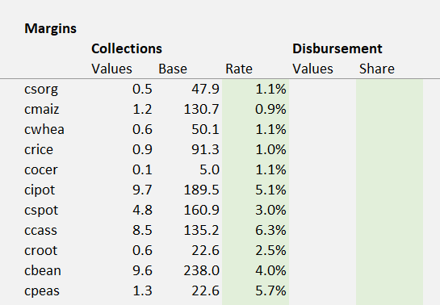
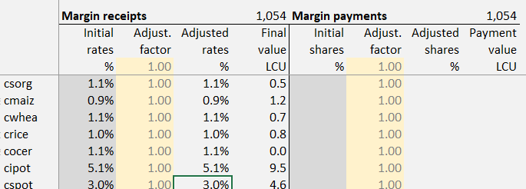
Action 12 | Transaction Costs
Transaction cost margin rates derived from SUT2017
  Margin collections estimated from demand/supply flows in SUT sheet
Data recorded in SUT_2017.xlsx
Trade and transport margin rates

Slide 29
Step 3: Income Distribution
Disaggregate and balance labor and household accounts

Slide 30
Details
 | Act | Com | Fact | Ent | Hhd | Gov | Tax | S-I | Stk | Wld | Tot
Activities
Commodities
Factors
Enterprises
Households
Government
Taxes
Savings
Stock change
Rest of world
Total
17 factors
20 households

Slide 31
Nexus Factors & Households
Agricultural Sectors & Products
35
Maize | Sorghum + millet | Rice | Wheat + barley | Other cereals | Pulses | Groundnuts | Other oilseeds | Cassava | Irish potatoes | Sweet potatoes | Other roots | Leafy vegetables | Other vegetables | Sugarcane | Tobacco | Cotton + fibers | Nuts | Bananas + plantains | Other fruits | Tea | Coffee | Cocoa | Cut flowers | Rubber | Other crops | Cattle | Raw milk | Poultry | Eggs | Sheep + goats | Other livestock | Forestry | Aquaculture | Capture fisheries
Industrial Sectors & Products
39
Coal | Crude oil | Natural gas | Other mining | Meat | Fish + seafood | Dairy | Fruits + vegetables | Fats + oils | Maize milling | Sorghum + millet milling | Rice milling | Wheat + barley milling | Other grain milling | Sugar refining | Coffee processing | Tea processing | Other foods | Animal feed | Beverages | Tobacco | Cotton yarn | Textiles | Clothing | Leather + footwear | Wood | Paper | Petroleum | Chemicals | Non-metal minerals | Metals + metal products | Machinery | Equipment | Vehicles | Other manufacturing | Electricity + gas | Water supply + sewage | Construction
Service Sectors & Products
12
Wholesale + retail trade | Transportation + storage | Accommodation | Food services | Information + communication | Finance + insurance | Real estate activities | Business services | Public administration | Education | Health + social work | Other services
Factors of Production
17
Crop land | Crop, livestock, mining and nonagricultural capital | Rural, urban and Kigali labor by education category
Household groups
20
Rural farm, rural nonfarm, urban and Kigali households by national per capita expenditure quintiles

Slide 32
Data Sources
Main data sources:
Household & labor force surveys
Map sector of employment to Nexus activities
ISIC3.1, ISIC4 → Disaggregated SAM accounts
Map consumption items to Nexus commodities
COICOP, etc. → Disaggregated SAM accounts
Maintain macro SAM & non-factor/household accounts
Only imbalances are for detailed household accounts
Balanced using cross-entropy in GAMS

Slide 33
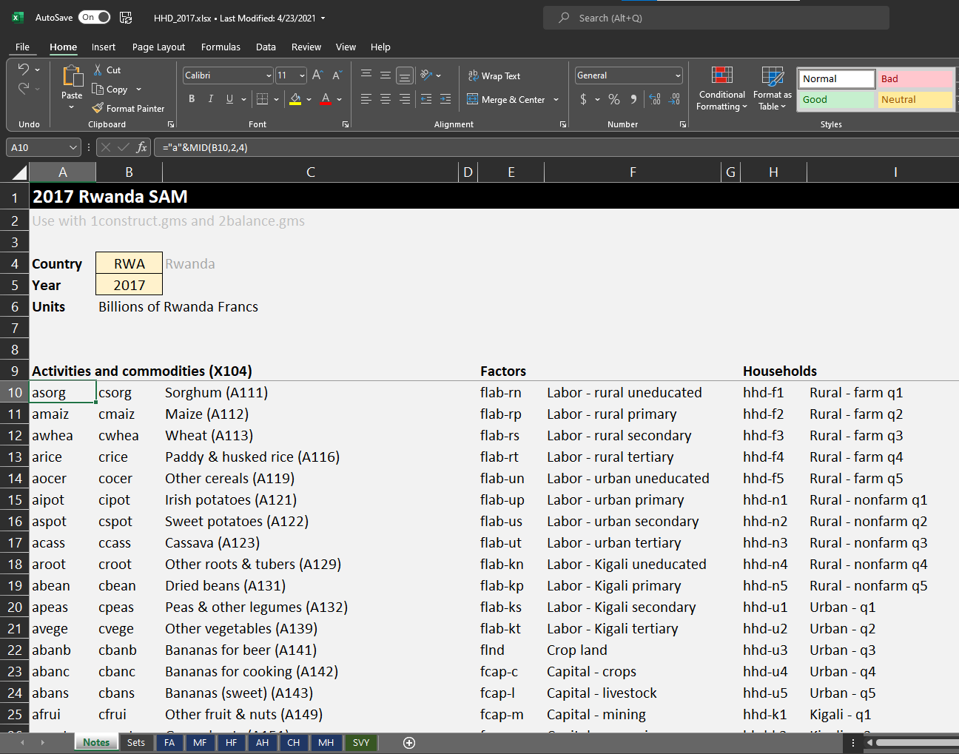
Household Excel File
More detailed factors and households
Blue sheets are imported into GAMS
Green sheet contains information from household and labor force surveys
HHD_2017.xlsx | Notes

Slide 34
Factor & Household Worksheets
FA Income generation (activity payments to factors)
MF Non-activity receipts and payments for factors
HF Income distribution (factor payments to households)
AH Household own consumption shares
CH Household marketed consumption shares
MH Non-commodity/factor transactions for households
SVY Raw data from surveys, transformed to Nexus accounts
HHD_2017.xlsx | Notes

Slide 35
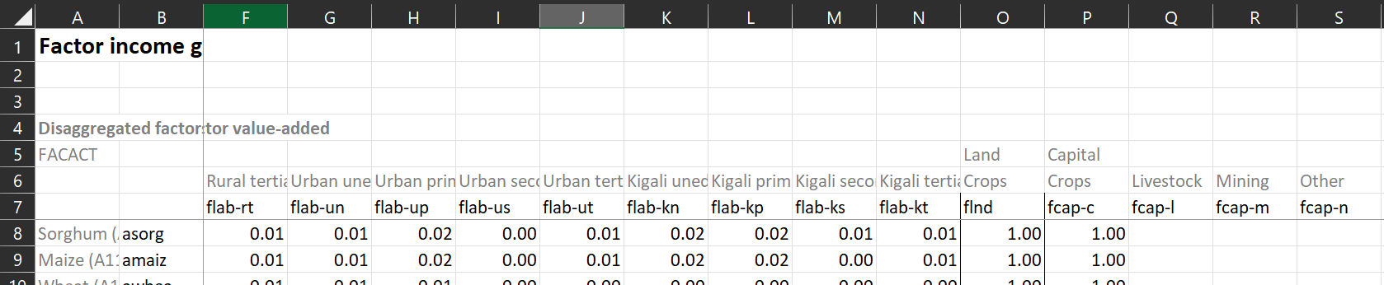
Income Generation Matrix
Share of each sector’s value added allocated to different factors
  Within labor (8 types) and within capital (4 types)
Data from labor force and/or household surveys
  Information on sectoral employment, including earnings from wages, nonfarm enterprises, an crop and livestock production
Raw survey data imported and adjusted on “Survey” sheet
Labor earnings (sums to 1)
HHD_2017.xlsx | FA

Slide 36
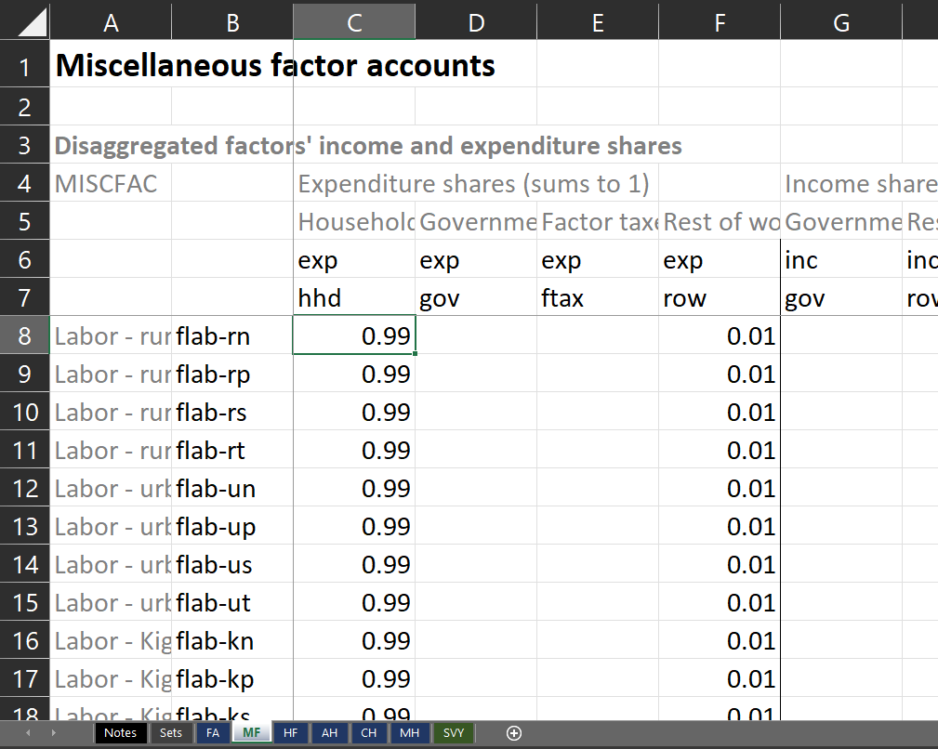
Income Distribution Matrix
Share of each factor’s earnings distributed to different households
  13 factors across 15 households
Household survey data
  On Survey sheet
Adjustments needed to avoid outliers
  Also on Survey sheet
HHD_2017.xlsx | HF
Factor payments (sums to 1 across households)

Slide 37
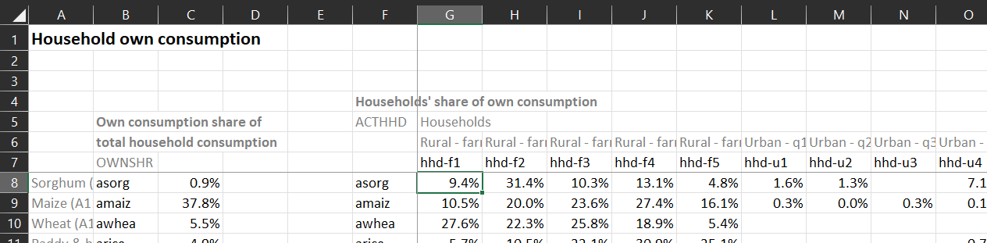
Household Consumption Matrices
Data on own & marketed consumption (ActHhd & ComHhd)
Share of each product’s total consumption demand generated by different households
  30 commodities across 15 households
Household survey data
  On Survey sheet
HHD_2017.xlsx | AH
Product consumption shares (sum to 1)

Slide 38
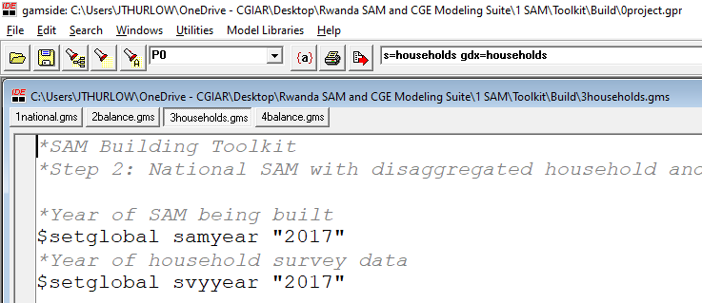
Building the Household SAM in GAMS
Click on household SAM build file (3households.gms)
Check that you are using the correct data file (2017)
Press F9 (or click on Run Button)
Check process window (Normal Completion)
3households.gms

Slide 39
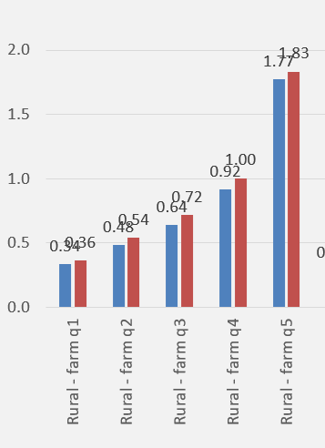
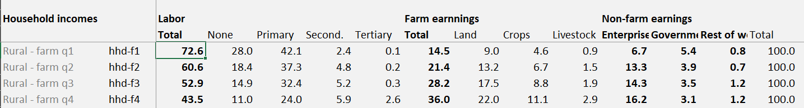
Household Imbalances
Check HHD_Check.xlsx
Household information
  Income shares across factors & other sources
  Comparison of survey vs. SAM per capita consumption
  Household incomes vs. expenditures
HHD_Check.xlsx | Workings

Slide 40
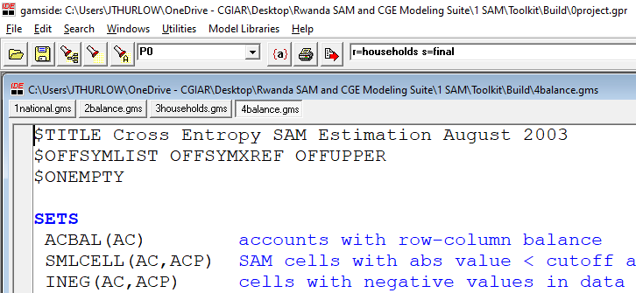
Balancing the SAM in GAMS
Click on SAM balancing file (4balance.gms)
Check you are restarting from the previous file (r=households)
Press F9 (or click on Run Button)
Check process window (Optimal Solution & Normal Completion)
4balance.gms

Slide 41
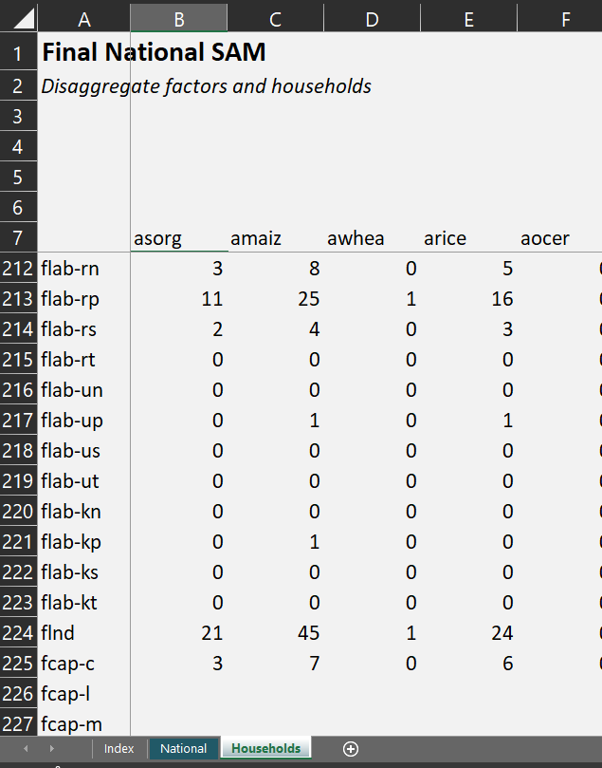

Viewing Balanced Household SAM
Balanced SAMs are exported to the SAM_2017.xlsx file
Check HHD_Check.xlsx again to see how income and expenditure share changed during balancing
SAM_2017.xlsx | Household sheet

Slide 42
Data Sources
Main data sources:
Household survey (EICV) & labor force survey (LFS)
Maintain macro-SAM & non-factor/household accounts
Only imbalances are for detailed household accounts
Balanced using cross-entropy in GAMS

Slide 43
Survey Data Worksheet
SVY Raw data from surveys, transformed to Nexus accounts
Block 1: Labor Income generation (FA)
    EICV Wages | Nonfarm enterprises | Crop earnings | Livestock earnings
    LFS Wages
Block 2: Consumption (AH, CH)
  Own vs. market consumption shares
  Home consumption breakdown
  Marketed consumption breakdown
Block 3: Factor payments to households (HF)
  EICV Wages | Nonfarm enterprises | Crop earnings | Livestock earnings
Block 4: Miscellaneous incomes and expenditures (MH)

Slide 44
Constraints & Principles
Data constraints
  EICV survey is an imperfect reflection of the population’s true incomes and expenditures
    Sample, not census
    Limited set of questions (esp. on income side)
    Imperfect recall/answers (e.g., taxes, assets, savings)
  LFS has better labor income capture, but no matching consumption data
Principles for overcoming constraints
  Data is a proxy for reality – can be adjusted
  Look for regularities (e.g., poor households earn more uneducated labor wages)
  Confirm or replace with other sources if possible (e.g., direct tax rates)

Slide 45
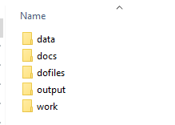
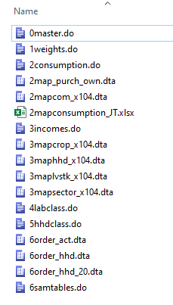
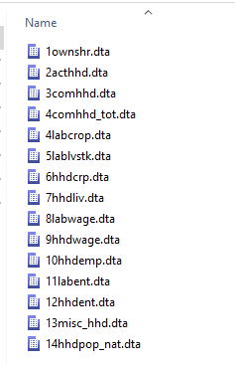
EICV Processing Using Stata
Folders
Do files
Output files

